Slide 2
Creative Thinking
Research into the operation of the human brain shows that each hemisphere of the brain processes information differently and that one side of the brain tends to be dominant over the other. The human brain develops asymmetrically, and each hemisphere tends to specialize in certain functions.
The left-brain is guided by linear, vertical thinking (from one logical conclusion to the next), whereas the right-brain relies on kaleidoscopic, lateral thinking (considering a problem from all sides and jumping into it at different points). The left-brain handles language, logic, and symbols; the right-brain takes care of the body’s emotional, intuitive, and spatial functions. The left-brain processes information in a step by-step fashion, but the right-brain processes it intuitively—all at once, relying heavily on images.

Slide 3
Left-brained, vertical thinking is narrowly focused and systematic, proceeding in a highly logical fashion from one point to the next. Right-brained, lateral thinking, on the other hand, is somewhat unconventional, unsystematic, and unstructured, much like the image of a kaleidoscope whirling around to form one pattern after another. Right-brain driven, lateral thinking lies at the heart of the creative process.

Slide 4
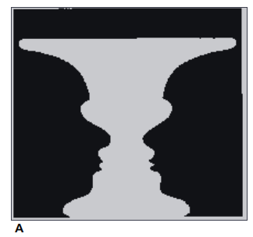
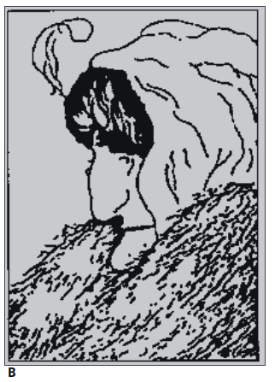
What Do You See?

Slide 5
Creativity Process
Step 1. Preparation
This step involves getting the mind ready for creative thinking. Preparation might include a formal education, on-the-job training, work experience, and other learning opportunities. This training provides a foundation on which to build creativity and innovation. As one writer explains, “Creativity favors the prepared mind.”For example, Dr. Hamel Navia, a scientist at tiny Vertex Pharmaceuticals, was working on a promising new drug to fight the AIDS virus. His preparation included earning an advanced degree in the field of medicine and learning to use computers to create three-dimensional images of the protein molecules he was studying. How can you prepare your mind for creative thinking?
Adopt the attitude of a lifelong student. Realize that educating yourself is a never-ending process. Look at every situation you encounter as an opportunity to learn.
Read—a lot—and not just in your field of expertise. Many innovations come from blending ideas and concepts from different fields in science, engineering, business, and the arts. Reading books, magazines, and papers covering a variety of subject matter is a great way to stimulate your creativity.
Clip interesting articles and create a file for them. Over time, you will build a customized encyclopedia of information from which to draw ideas and inspiration

Slide 6
Step 2. Investigation
This step requires one to develop a solid understanding of the problem, situation, or decision at hand. To create new ideas and concepts in a particular field, an individual first must study the problem and understand its basic components. Creative thinking comes about when people make careful observations of the world around them and then investigate the way things work (or fail to work). For example, Dr. Navia and another scientist at Vertex had spent several years conducting research on viruses and on a protein that blocks a virus enzyme called protease. His exploration of the various ways to block this enzyme paved the way for his discovery.

Slide 7
Step 3. Transformation
Transformation involves viewing the similarities and the differences among the information collected. This phase requires two types of thinking: convergent and divergent. Convergent thinking is the ability to see the similarities and the connections among various and often diverse data and events. “So much of innovation comes from connecting things where other people don’t make connections,” says Mark Rice, professor of technology entrepreneurship at Olin College.
Divergent thinking is the ability to see the differences among various data and events. While developing his AIDS fighting drug, Dr. Navia studied the work of other scientists whose attempts at developing an enzyme-blocking drug had failed. He was able to see the similarities and the differences in his research and theirs and to build on their successes while avoiding their failures.

Slide 8
Step 4. Incubation
The subconscious needs time to reflect on the information collected. To an observer, this phase of the creative process would be quite boring; it looks as though nothing is happening! In fact, during this phase, it may appear that the creative person is loafing. Incubation occurs while the individual is away from the problem, often engaging in some totally unrelated activity. Dr. Navia’s creative powers were working at a subconscious level even when he was away from his work, not even thinking about his research on AIDS-fighting drugs.
How can you enhance the incubation phase of the creative process, letting ideas marinate in your mind?
Walk away from the situation.
Take the time to daydream
Relax—and play—regularly
Dream about the problem or opportunity
Work on the problem or opportunity in a different environment—somewhere other than the office

Slide 9
Step 5. Illumination
This phase of the creative process occurs at some point during the incubation stage when a spontaneous breakthrough causes “the light bulb to go on.” It may take place after five minutes—or five years. “An insight is an unexpected shift in the way we understand things,” says Gary Klein, a clinical psychologist and author. “It comes without warning. It’s not something that we think is going to happen. It feels like a gift, and, in fact, it is.”In the illumination stage, all the previous stages come together to produce the “Eureka factor”—the creation of the innovative idea. In one study of 200 scientists, 80 percent said at least once a solution to a problem had “just popped into their heads”—usually when they were away from the problem. For Dr. Navia, the illumination stage occurred one day while he was reading a scientific journal. As he read, Dr. Navia says he was struck with a “hallucination” of a novel way to block protease.
Although the creative process itself may last for months or even years, the suddenness with which the illumination step occurs can be deceiving, making the process appear to occur much faster than it actually does.

Slide 10
Step 6. Verification
For entrepreneurs, validating an idea as realistic and useful may include conducting experiments, running simulations, test-marketing a product or service, establishing small-scale pilot programs, building prototypes, and many other activities designed to verify that the new idea will work and is practical to implement. The goal is to subject the innovative idea to the test of cold, hard reality.
At this phase, appropriate questions to ask include the following:
Is it really a better solution to a particular problem or opportunity? Sometimes an idea that appears to have a bright future in the lab or on paper dims considerably when put to the test of reality.
Will it work?
Is there a need for it?
If so, what is the best application of this idea in the marketplace?
Does this product or service idea fit into our core competencies?
How much will it cost to produce or to provide?
Can we sell it at a reasonable price that will produce adequate sales, profit, and return on investment for our business?

Slide 11
Step 7. Implementation
The focus of this step is to transform the idea into reality. Plenty of people come up with creative ideas for promising new products or services, but most never take them beyond the idea stage. What sets entrepreneurs apart is that they act on their ideas. An entrepreneur’s philosophy is “Ready, aim, fire,” not “Ready, aim, aim, aim, aim.” Innowattech, a company based in Ra’anana, Israel, has developed a variety of piezoelectric (PE) crystals that possess the ability to transform vibrations, motion, and temperature changes into clean energy. Like miniature generators, the pressure-sensitive ceramic crystals give off small electrical charges when “squeezed, squashed, bent, or slapped,” says Markys Cain, a materials scientist. In a recent test, Innowattech placed PE generators two inches beneath a small section of Israel’s busy Highway 4, where passing cars compressed the road, activated the tiny generators, and produced energy. The company estimates that placing the PE crystals under a one-half-mile stretch of highway would generate enough energy to supply 250 homes. Innowattech also has developed crystals for collecting clean energy from railways, airport runways, and pedestrian walkways.

Slide 12
Techniques for Improving the Creative Process
Teams of people working together usually can generate more and more creative ideas. Five techniques that are especially useful for improving the quality of creative ideas from teams are brainstorming, mind mapping, force-field analysis, TRIZ, and rapid prototyping.
Brainstorming
Brainstorming is a process in which a small group of people interact with very little structure with the goal of producing a large quantity of novel and imaginative ideas. The goal is to create an open, uninhibited atmosphere that allows members of the group to “freewheel” ideas. Participants should suggest any ideas that come to mind without evaluating or criticizing them. As group members interact, each idea sparks the thinking of others, and the spawning of ideas becomes contagious. The free-flowing energy generated by the team becomes the genesis of a multitude of ideas, some of which may be impractical; however, those impractical ideas may lead to one idea that results in a breakthrough product or service for a company.

Slide 13
For a brainstorming session to be successful, entrepreneurs should follow these guidelines:
Keep the group small—just five to eight members. Amazon founder Jeff Bezos uses the “two-pizza rule”—if a brainstorming group can eat two pizzas, it’s too big.
Make the group as diverse as possible. Include people with different backgrounds, disciplines, and perspectives. At Joe Design Inc., every employee in the small firm takes part in brainstorming sessions. “We bring in everybody from the bookkeeper to the office manager because they see things completely differently than we do,” says cofounder Joe Raia.
Encourage participants to engage in some type of aerobic exercise before the session. One study found that people who exercise—walking, bicycling, swimming, or running—before brainstorming sessions were more creative than those who did not exercise.
Ignore company rank and department affiliation. Every member of the brainstorming team is on equal ground.
Give the group a well-defined problem. Stating the problem in the form of a “why,” “how,” or “what” question often helps.
Rather than waste precious group meeting time getting participants up to speed, provide everyone involved in the session with relevant background material about the problem to be solved beforehand. Invite participants to submit at least three ideas by e-mail before the brainstorming session takes place. This gets people’s minds focused on the issue.

Slide 14
Limit the session to 40 to 60 minutes. Beyond that, participants grow weary, and creativity flags because brainstorming is an intense activity.
Take a field trip. Visit the scene of the problem, if possible. Research shows that brainstorming teams that go “on site” actually come up with more and better ideas.
Appoint someone (preferably not a brainstorming participant) the job of recorder. The recorder should write every idea on a flip chart or board so that everyone can see it.
Use a seating pattern that encourages communication and interaction (e.g., circular or U-shaped arrangements).
Throw logic out the window. The best brainstorming sessions are playful and anything but logical.
Encourage all ideas from the team, even wild and extreme ones. Discourage participants from editing their ideas. Not only can ideas that initially seem crazy get the group’s creative juices flowing, but they also can spread creativity like wildfire. In addition, the group often can polish some of these wild ideas into practical, creative solutions.

Slide 15
Mind Mapping
Another useful tool for jump-starting creativity is mind mapping, an extension of brainstorming. One strength of mind mapping is that it reflects the way the brain actually works. Rather than throwing out ideas in a linear fashion, the brain jumps from one idea to another. In many creative sessions, ideas are rushing out so fast that many are lost if a person attempts to shove them into a linear outline. Creativity suffers. Mind mapping is a graphical technique that encourages thinking on both sides of the brain, visually displays the various relationships among ideas, and improves the ability to view a problem from many sides.

Slide 16
The mind-mapping process works this way:
Start by writing down or sketching a picture symbolizing the problem or area of focus in the center of a large blank page. Tony Buzan, originator of the mind-mapping technique, suggests using ledger paper or covering an entire wall with butcher paper to establish a wide-open attitude toward creativity.
Write down every idea that comes into your mind, connecting each idea to the central picture or words with a line. Use key words and symbols to record ideas in shorthand. Work as quickly as possible for no more than 20 minutes, doing your best to capture the tide of ideas that flows from your brain. Just as in brainstorming, do not judge the quality of your ideas; just get them onto the paper. Build new ideas on the backs of existing ones. If you see a connection between a new idea and one already on the paper, connect them with a line. If not, simply connect the idea to the center symbol. You will organize your ideas later in the process.
When the flow of ideas slows to a trickle, stop! Don’t try to force creativity.
Allow your mind to rest for a few minutes and then begin to integrate the ideas on the page into a mind map. Use colored pens and markers to connect ideas with similar themes or to group ideas into related clusters. As you organize your thoughts, look for new connections among your ideas.

Slide 17
Force-Field Analysis
Force-field analysis is a useful technique for evaluating the forces that support and oppose a proposed change. It allows entrepreneurs to weigh both the advantages and the disadvantages of a particular decision and work to maximize the variables that support it and minimize those that work against it. The process, which, like brainstorming, works well with a group, begins by making three columns and listing the problem to be addressed in the center column. In the column on the left, the group should list driving forces, those that support the issue and move it forward. In the column on the right, the group should list the restraining forces, those that hold back the company from implementing the idea. The specific forces that the group may come up with are almost limitless, but some of the factors the team should consider include people, values, costs, trends, traditions, politics, costs, revenues, environmental impact, regulations, and attitudes.
Once the group has identified a reasonable number of driving and restraining forces (4 to 10 is typical), the next task is to assign a numerical value that reflects the strength of that particular force. For the driving forces column, scores range from 1 (weak) to 4 (strong), and in the restraining forces column, scores range from −1 (weak) to −4 (strong). Adding the scores for the driving forces column and the restraining forces column shows which set of forces dominates the issue. The higher the total score, the more feasible is the idea. If the decision is a “go,” the group can focus on ideas to create new driving forces, strengthen existing driving forces, and minimize the impact of restraining forces.

Slide 18
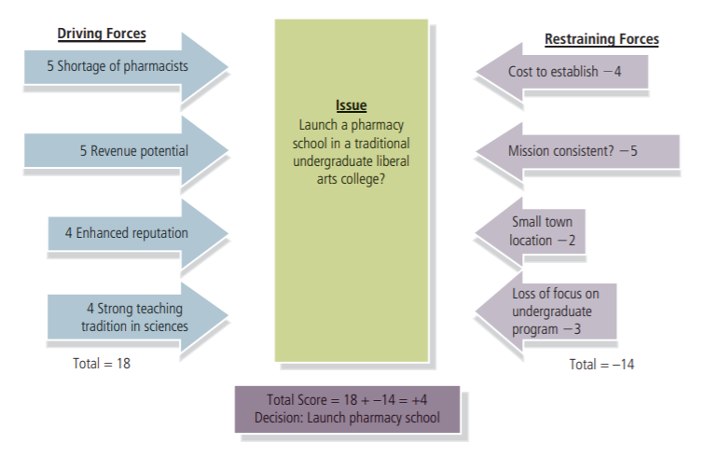
Sample Force-Field Analysis

Slide 19
TRIZ
Developed in 1946 by Genrich Altshuller, a 22-year-old naval officer in the former Soviet Union, TRIZ (pronounced “trees”) is a systematic approach designed to help solve any technical problem, whatever its source. The name is derived from the acronym for the Russian phrase that translates as “theory of inventive problem solving.” Unlike brainstorming and mind mapping, which are right-brain activities, TRIZ is a left-brain, scientific, step-by-step process that is based on the study of hundreds of the most innovative patents across the globe. Altshuller claimed that these innovations followed a particular set of patterns. Unlocking the principles behind those patterns allows one not only to solve seemingly insurmountable problems but also to predict where the next challenges would arise. Altshuller and his colleagues developed 40 principles underlying these innovative patents and then developed the “TRIZ contradiction matrix,” a tool that combines these principles to solve a problem. They recognized that innovations come about when someone is able to overcome the inherent contradictions in a process. For instance, in the packaging industry, a contradiction exists between the effectiveness of childproof safety caps for medicine containers and making those containers easy for authorized users to open. Manufacturers of mattresses face the contradiction of making mattresses that are both hard and soft. Too often, companies rely on a very unimaginative solution to contradictions such as these; they compromise. Rather than settle for a mediocre compromise, the TRIZ contradiction matrix is designed to resolve these conflicts using the 40 principles that Altshuller developed. One axis of the matrix displays the characteristic of the process to be improved, and the other axis displays the conflicting characteristic that is becoming worse.

Slide 20
Rapid Prototyping
Generating creative ideas is a critical step in the process of taking an idea for a product or a service successfully to market. However, recall that many (perhaps most) ideas that entrepreneurs come up with fail. Inventor and serial entrepreneur Scott Jones says his kids still enjoy teasing him about one of his offbeat ideas that flopped: a pair of microturbines embedded in the soles of shoes that would propel the wearer forward. (Jones abandoned the idea after seeing a similar concept fail flamboyantly in the movie Jackass.) Rapid prototyping plays an important part in the creative process because it serves as a way to screen ideas that are not practical or just won’t work so that entrepreneurs can focus their creative energy on other ideas. The premise behind rapid prototyping is that transforming an idea into an actual model points out flaws in the original idea and leads to improvements in its design. “If a picture is worth a thousand words, a prototype is worth ten thousand,” says Steve Vassallo of Ideo Inc.

Slide 21
The three principles of rapid prototyping are the three Rs: rough, rapid, and right. Models do not have to be perfect; in fact, in the early phases of developing an idea, perfecting a model usually is a waste of time. The key is to make the model good enough to determine what works and what does not. Doing so allows an entrepreneur to develop prototypes rapidly, moving closer to a successful design with each iteration. The final R, right, means building lots of small models that focus on solving particular problems with an idea. “You’re not trying to build a complete model,”says Vassallo. “You’re just focusing on a small section of it.”

Slide 22
Intellectual Property: Protecting Your Ideas
Once entrepreneurs come up with innovative ideas for a product or service that has market potential, their immediate concern should be to protect them from unauthorized use. Counterfeit goods pose a real threat to businesses that have created intellectual property and their customers who use the products based on that intellectual property. The World Trade Organization estimates that between 5 and 7 percent of all goods traded globally are counterfeit. Research by the International Chamber of Commerce concludes that the value of counterfeit goods sold globally exceeds $1.7 trillion.
Patents
A patent is a grant from the U.S. Patent and Trademark Office (PTO) to the inventor of a product, giving the exclusive right to make, use, or sell the invention (and to prevent others from making, using or selling it) in this country for 20 years from the date of filing the patent application. The purpose of giving an inventor a 20-year monopoly over a product is to stimulate creativity and innovation. After 20 years, the patent expires and cannot be renewed, and the invention becomes part of the public domain. The popular Keurig single-cup coffee machine is protected by 37 patents, but two of its most crucial patents expired in 2012, opening the door for competitors to introduce their own versions of the device.

Slide 23


Slide 24
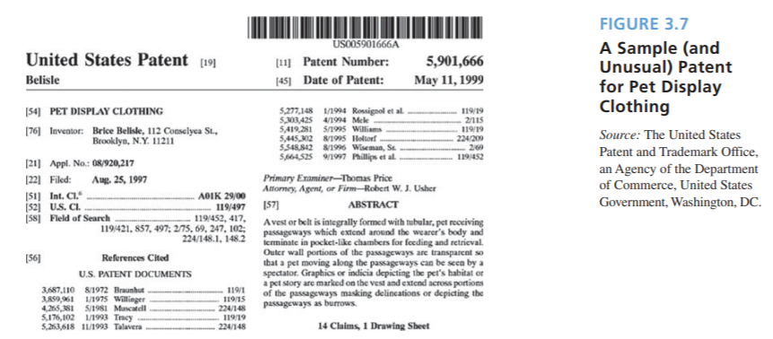
Patent Process: To receive a patent, an inventor must follow these steps:
Establish the invention’s novelty.
Document the device.
Search existing patents.
Study search results.
Complete a patent application.
File the patent application

Slide 25
Since George Washington signed the first patent law in 1790, the PTO (www.uspto.gov) has issued patents on everything imaginable (and some unimaginable items, too), including mouse traps (of course!), Robert Fulton’s steamboat, animals (genetically engineered mice), Thomas Edison’s light bulb, golf tees (764 different patents), games, and various fishing devices. The J. M. Smucker Company even holds a patent issued in 1999 on a “sealed, crustless sandwich,” a peanut butter and jelly sandwich it markets very successfully under the name “Uncrustables.” The PTO also has issued patents on business processes—methods of doing business—including Amazon.com’s controversial patent on its “1-Click” technology, which allows users to store their customer information in a file and then recall it with one mouse click at checkout. Google recently received a patent for a system of “advertising based on environmental conditions.” The patent gives Google the exclusive right to use the technology to send targeted ads to users depending on the temperature, for example (e.g., ads for winter coats when the temperature dips into the 30s or rain gear when it rains).

Slide 26
Trademarks
A trademark is any distinctive word, phrase, symbol, design, name, logo, slogan, or trade dress that a company uses to identify the origin of a product or to distinguish it from other goods on the market. (A service mark is the same as a trademark except that it identifies and distinguishes the source of a service rather than a product.) A trademark serves as a company’s “signature” in the marketplace. A trademark can be more than just a company’s logo, slogan, or brand name; it can also include symbols, shapes, colors, smells, or sounds. For instance, Coca-Cola holds a trademark on the shape of its bottle, and Owens-Corning has trademarked the unique pink color of its insulation.

Slide 27
There are 1.88 million trademarks registered and in active use in the United States (see Figure 3.8). Federal law permits a company to register a trademark, which prevents other companies from employing a similar mark to identify their goods. Before 1989, a business could not reserve a trademark in advance of use. Today, the first party who either uses a trademark in commerce or files an application with the PTO has the ultimate right to register that trademark. Before attempting to register a trademark, an entrepreneur must conduct a search to verify that it is not already in use or is too similar to an existing mark. BizFilings’ Trademark Explorer is a handy, low-cost tool for conducting trademark searches. Registering a trademark takes an average of 10.3 months from the time an entrepreneur submits the application. Unlike patents and copyrights, which are issued for limited amounts of time, trademarks last indefinitely as long as the holder continues to use it. However, between 5 and 6 years after a trademark’s registration date (and again between 9 and 10 years after the registration date and every 10 years after that), an entrepreneur must file an affidavit of use with the PTO. A trademark cannot keep competitors from producing the same product or selling it under a different name; it merely prevents others from using the same or confusingly similar trademark for the same or similar products.

Slide 28
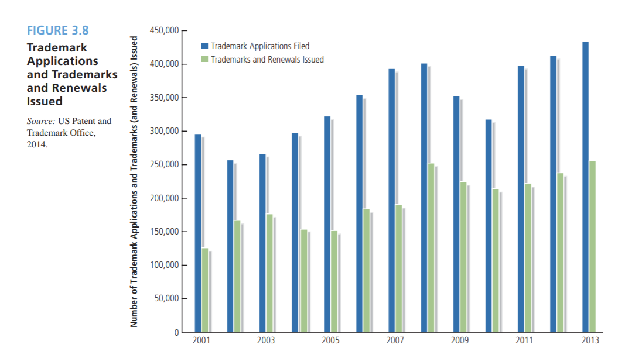

Slide 29
Copyrights
A copyright is an exclusive right that protects the creators of original works of authorship, such as literary, dramatic, musical, and artistic works (e.g., art, sculptures, literature, software, music, videos, video games, choreography, motion pictures, recordings, and others). The internationally recognized symbol © denotes a copyrighted work. A copyright protects only the form in which an idea is expressed, not the idea itself. A copyright on a creative work comes into existence the moment its creator puts that work into a tangible form. Just as with a trademark, obtaining basic copyright protection does not require registering the creative work with the U.S. Copyright Office (www.copyright.gov). Registering a copyright does give creators greater protection over their work, however. Entrepreneurs must file copyright applications with the Copyright Office in the Library of Congress for a fee of $35 to $65 per application (plus recording fees). The mean processing time for a copyright application is 94 days. A valid copyright on a work lasts for the life of the creator plus 70 years after his or her death. When a copyright expires, the work becomes public property and can be used by anyone free of charge.

Slide 30
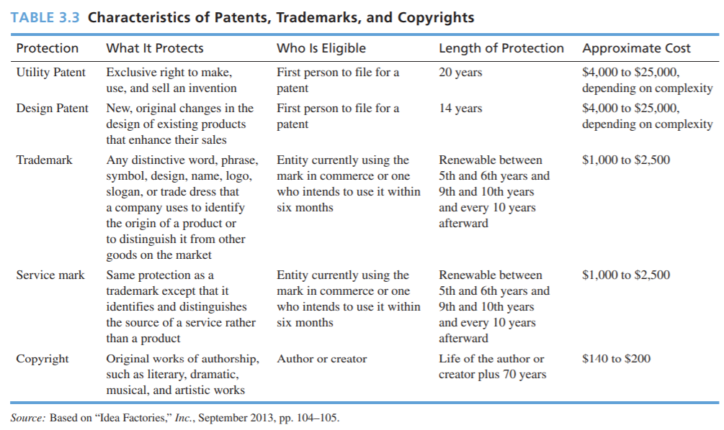

Slide 31
